Slide 1

IAIA Project 2024
IAIA Project #2
Gomoku & Checker Game Automation
Using UR5e Robot Arm
School of Mechanical & Control Engineering Course: Industrial AI and Automation
Kwak, Jin(21900031)
Lim, Soonho(21900610)
An, Gyeonheal(21900416)
Han, Taegeon(21900793)
Advisor: Prof. Young-Keun Kim
2024.12.10

Slide 2
Contents
Introduction
Five Stone in a row
Checker Game

Slide 3
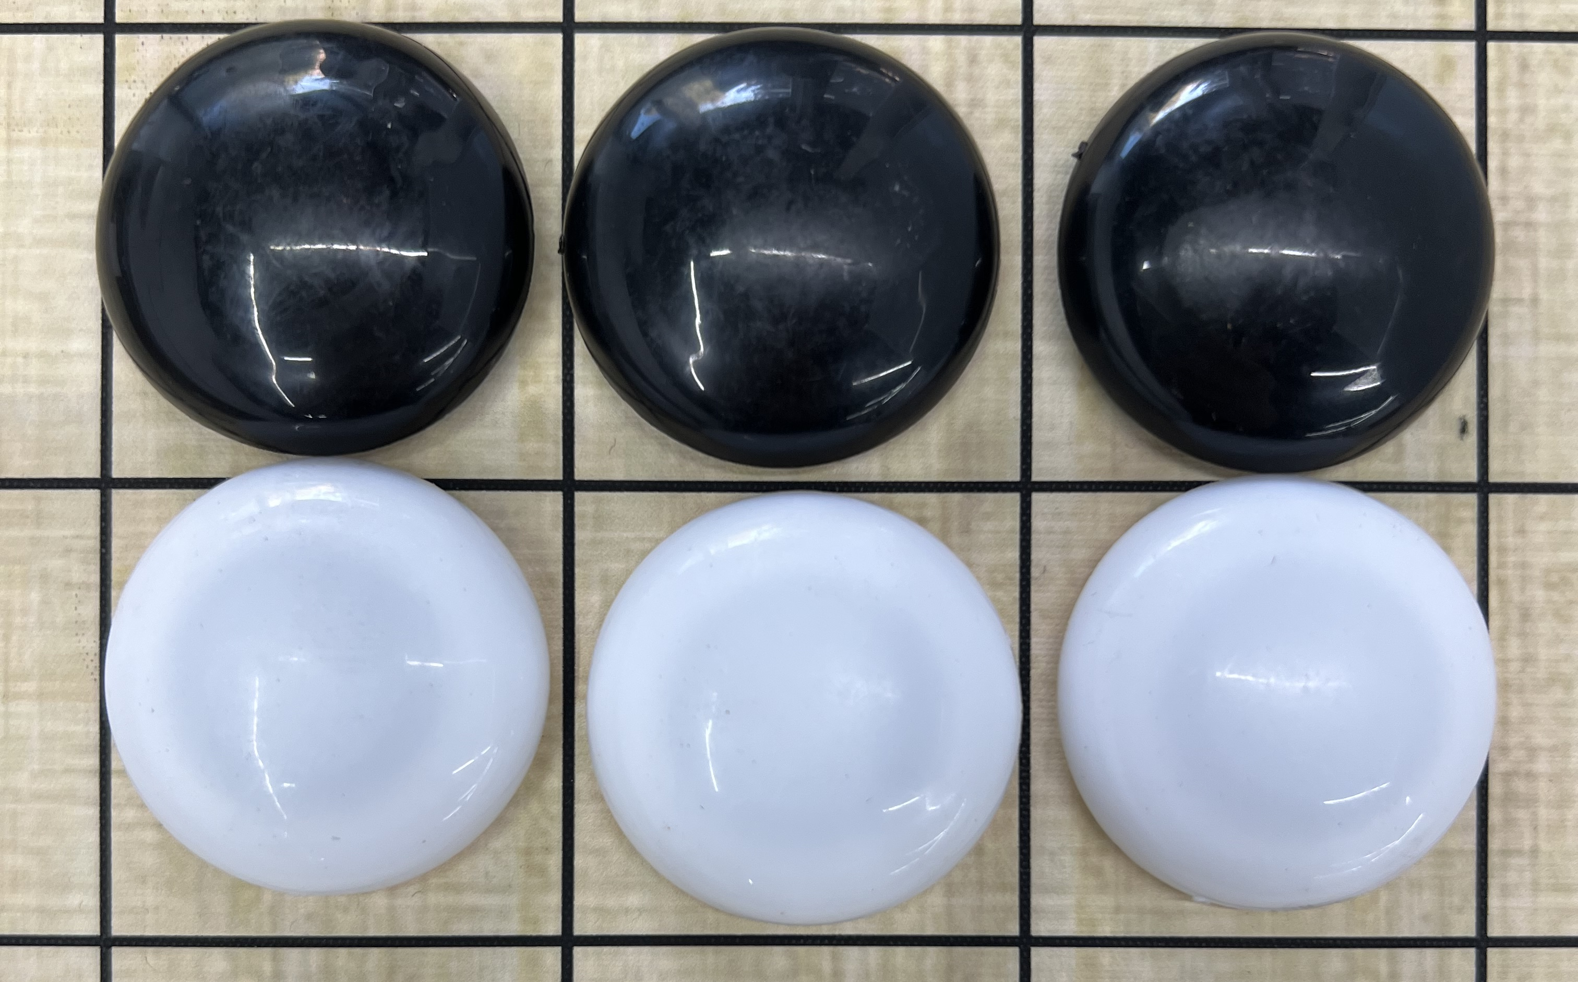
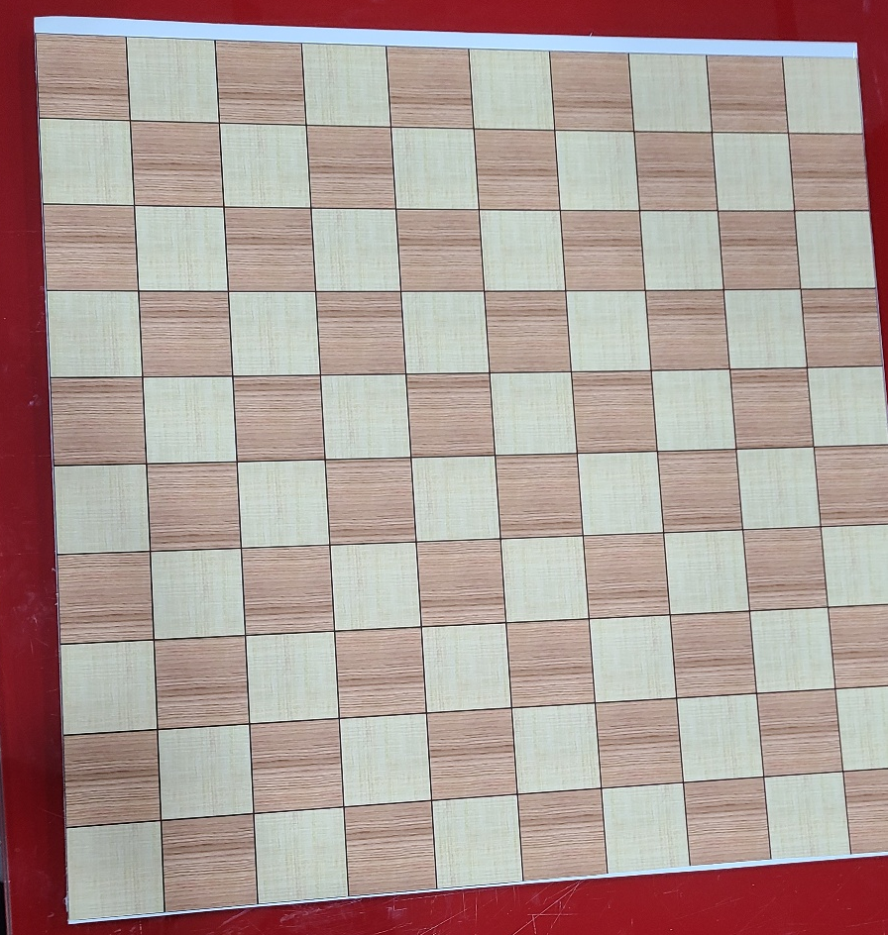
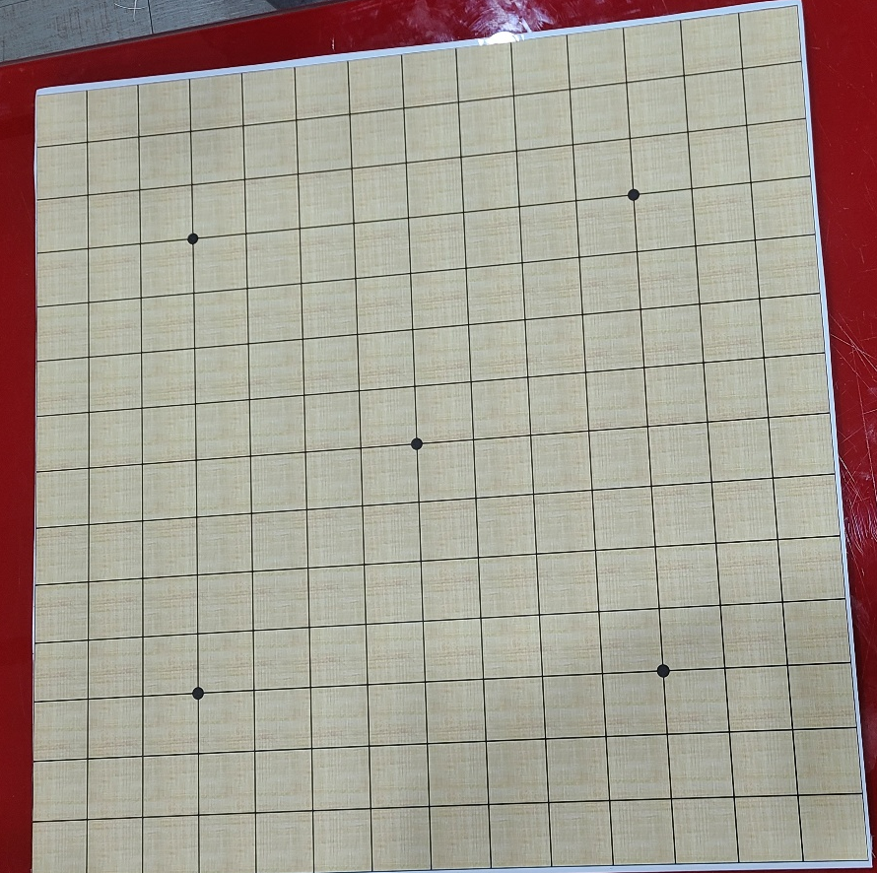
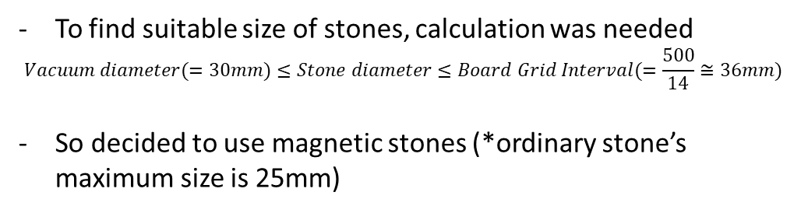
1. Hardware – Components
1. Board (Gomoku, Checker)
2. Stones
Should be smaller than optic table width(=700)
Should place other components (Stone tray, etc.)
(further research) Change the game mode by upside-down (Gomoku -> Checker)
Made double side multi-game board (500x500)
Sticks well to magnets (magnetic film)
Low price (100,000 → 50,000)
Used durable matters (hard board, magnetic film, angel cloth)
To find suitable size of stones, calculation was needed
$$Vacuum diameter(=30mm)≤Stone diameter≤Board Grid Interval(=\frac{500}{14}≅36mm)$$
So decided to use magnetic stones (*ordinary stone’s maximum size is 25mm)

Slide 4
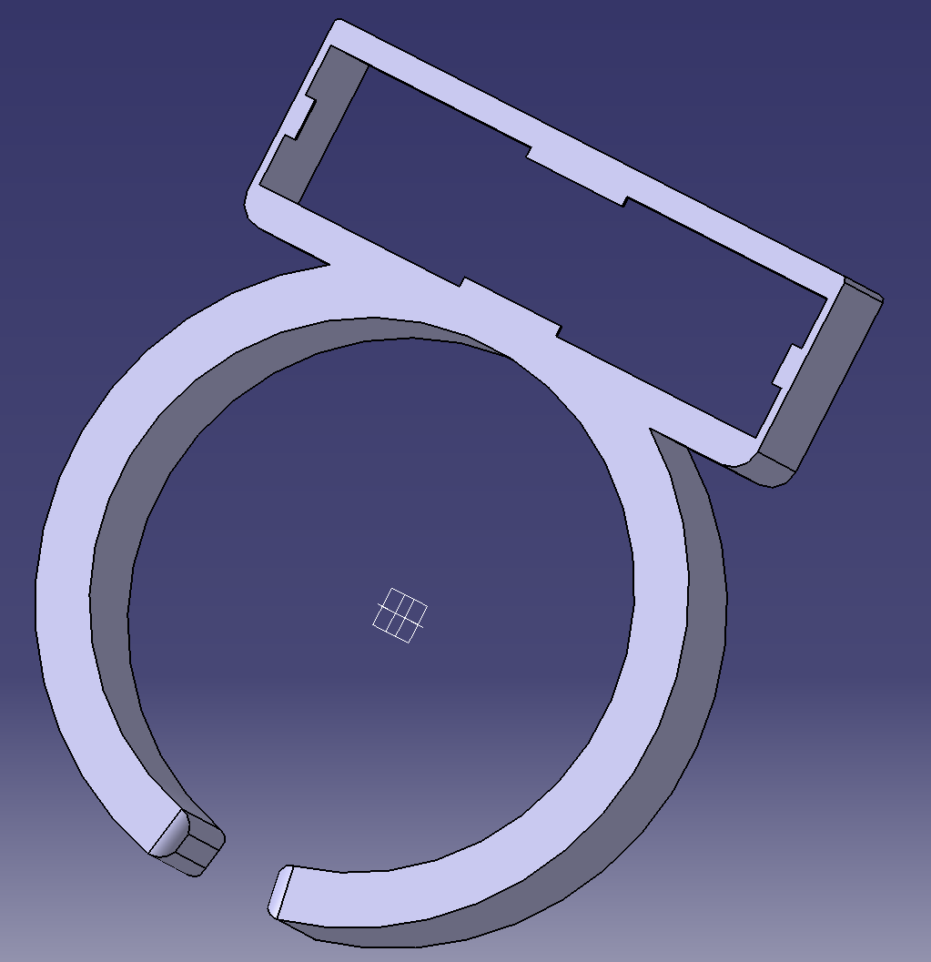
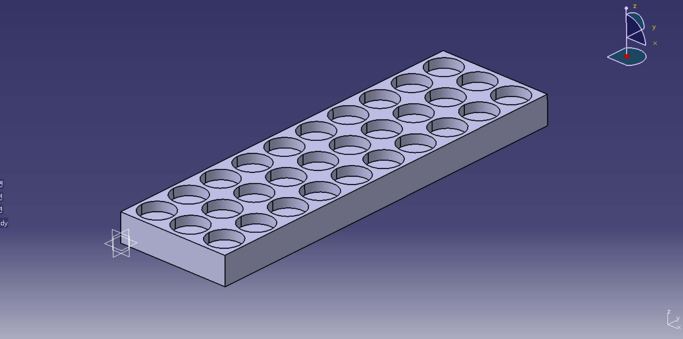
1. Hardware
2. Camera Holder
3. Stone Tray
Interaction with the vacuum gripper
Prone to rotation
Further improvement for the fixed camera position
Robot reloads the stones on this tray
Enable to fix the magnetic stones (*not to attach each others)
+ There was various structure to reload the stones (magazine, slider, etc.). But those were inappropriate for magnetic stones
*(print completes on Tues)

Slide 5
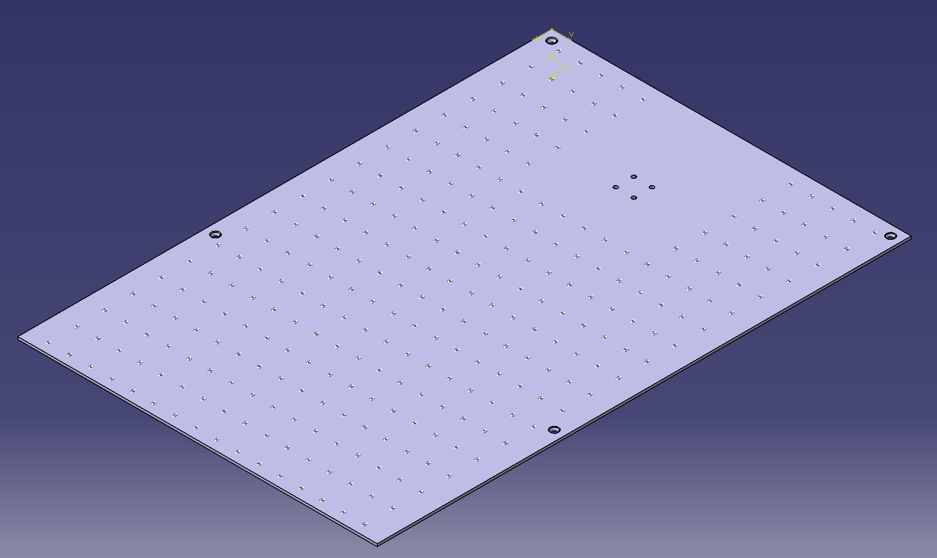
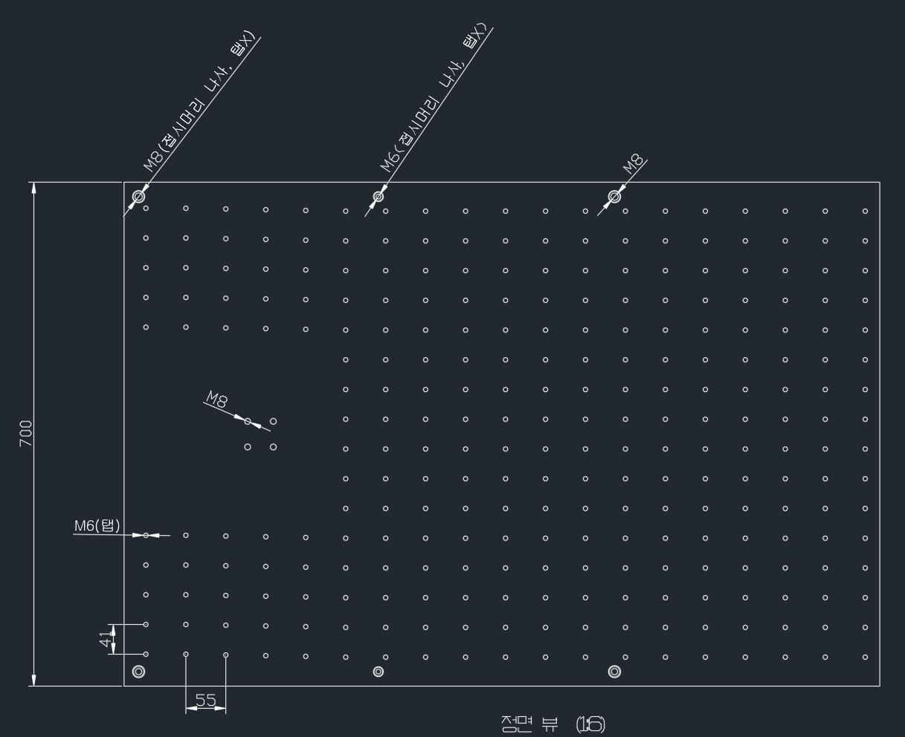
1. Hardware
4. Optic Table
Extra calibration for board position(e.g. height) is required
Optic table used to fix position for Gomoku board

Slide 6
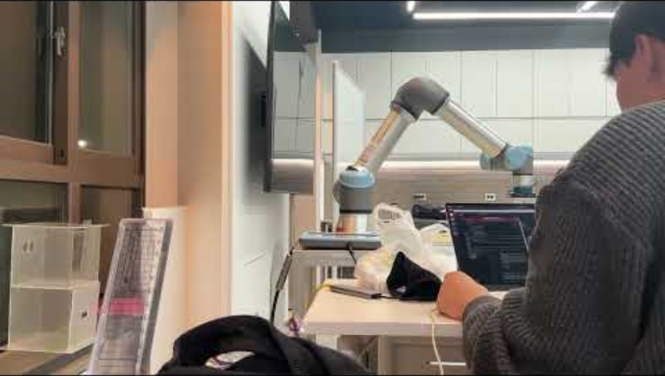
2. Software

Slide 7
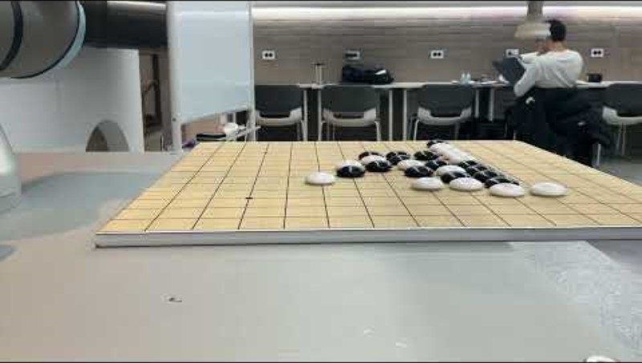
2. Software
Robot Input: Next stone coordinates
Robot Output: Movement to the position and drop gomoku stone
Possible: Manual Play (Human vs Human)

Slide 8
3. Next Plan
Next Plan
Fix the board position for accuracy
Rewrite Gomoku Game in python
Finish camera case/ stone tray,
Camera processing

